Slide 1
MARATHON KIDS UPDATE
Year One Children
Alfred Rudge
Alexander T
Lyla R
Scarlett M
Samuel F
Yichen H
Ana C-C
Olivia S
Leon T
Evelyn G
Harriet G
Harry S
Max U
Oscar W
Amber F
Jack G
Amelia I
Rosie D
Wow, again we have so many certificates to give out this week.
Well done everyone! Certificates will be given out by your teacher.
Names in bold are half marathon runners!
Year Two Children
Evie H
Amelie M- 72.2km
Tatum W
Daniela B
Nathan B- Marathon 1!!!
Sophia T
Bella P- 30km
Emma C- Marathon 1!!
Alexander G
Lottie-Mai Walsh

Slide 2
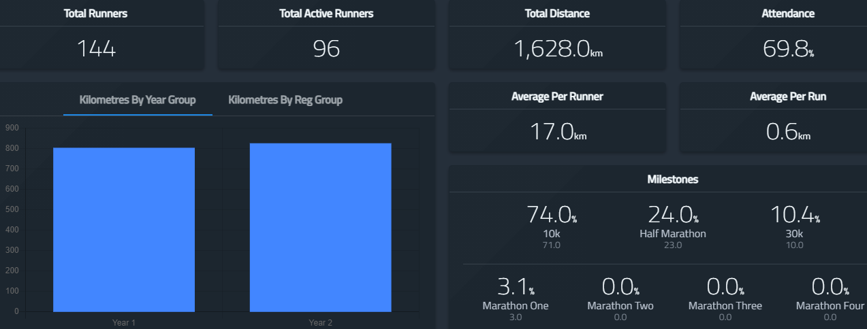
Milestone Summary
71 children have reached the 10km milestone!
We now have 23 children who have reached the half marathon milestone!
A further 10 children have reached the 30km target and
we have 3 children who have made it to the full marathon goal!! Amelie of course along with Nathan and Emma all from Maple class!

