Slide 1

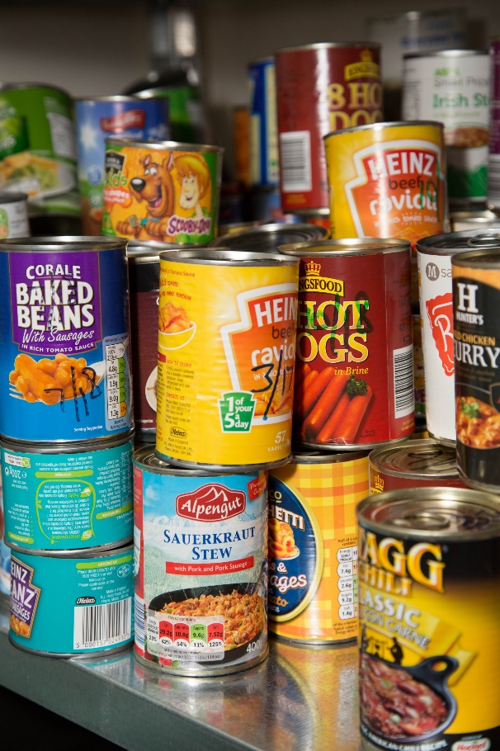
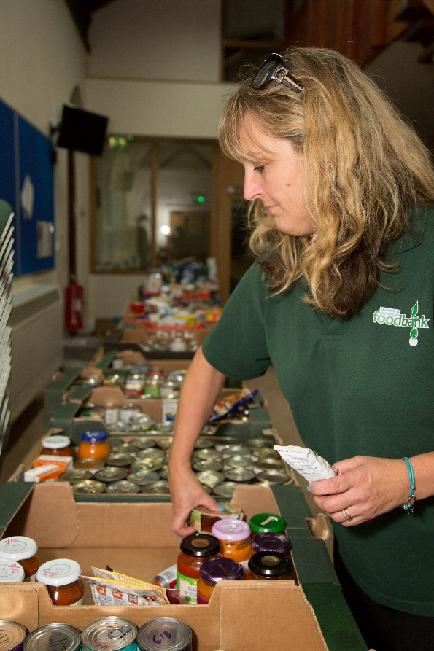
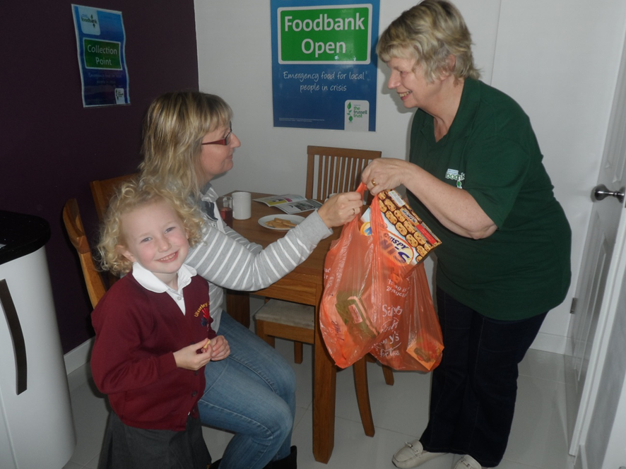
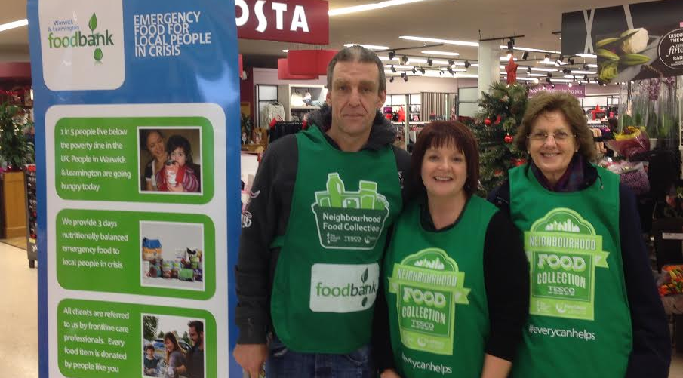
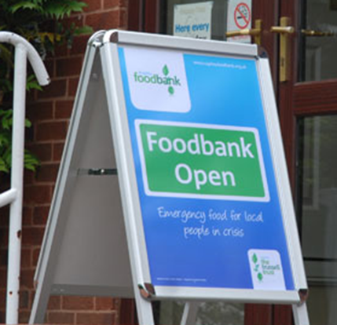

Warwick District Foodbank
Emergency food & support for local people in crisis
Warwick District Foodbank Is a Charitable Incorporated Organisation.
Registered charity number: 1160705 | Registered in England & Wales
Notes:
Introduce Started as a volunteer in 2013 . Paid position – running sessions more funding warehouse co-Ordinator. 9 years

Slide 2

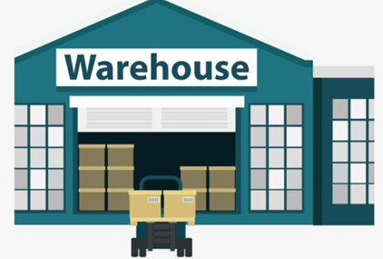

In 2021….
IN
OUT
49063 kgs
(10 average sized African elephants)
44242 kgs
(9 average sized African elephants)
Warwick District Foodbank Is a Charitable Incorporated Organisation.
Registered charity number: 1160705 | Registered in England & Wales

Slide 3
Covid Crisis
Change to working practices – prepacked bags, less chat, serving from door, no café service
Second half of the first year saw an increase in numbers due to furlough, school children being at home, people unable to work
But…
Increase in donations both financial & goods
Financial donations meant rental of new warehouse premises
Improved procedures – e.g. E-vouchers instead of paper vouchers
Warwick District Foodbank Is a Charitable Incorporated Organisation.
Registered charity number: 1160705 | Registered in England & Wales
Notes:
British Gas, Tesco –deal with TT. Sad to have donations from businesses who were closing

Slide 4

So far this year….
The average number of food parcels provided is currently 170 per week.
An increase of around 15% from last year.
Cost of living crisis – basic essentials more expensive
Increase in energy prices
Number of Ukrainian families needing food supplies
More referrals from schools – families who have previously been managing are finding they have no money left at the end of the month despite cutting back on spending.
Warwick District Foodbank Is a Charitable Incorporated Organisation.
Registered charity number: 1160705 | Registered in England & Wales
Notes:
Energy. Mention JS, parent making hospital trips, mother in tears can’t give her daughter (in 20’s) anymore help, self employed – sickness, PIP payments stopped for 18 yr old son, appeal took over 12 months. People who are making ends meet but only just, only need an unexpected event – car repairs, washing machine breakdown etc.

Slide 5
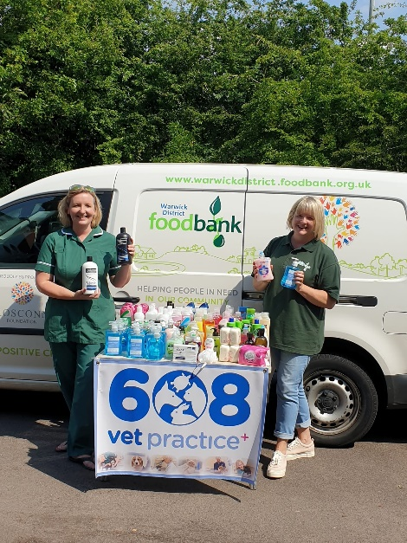


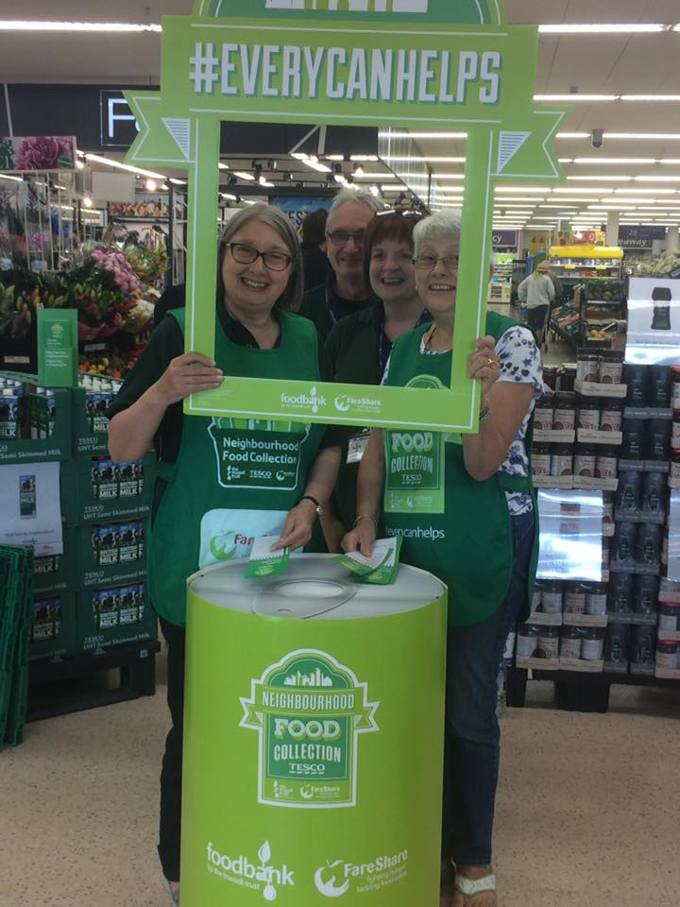
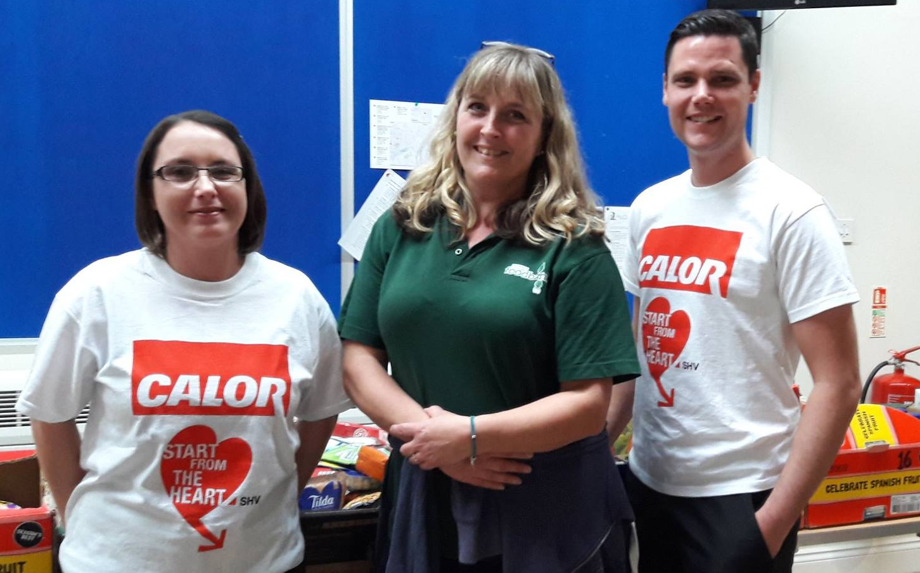
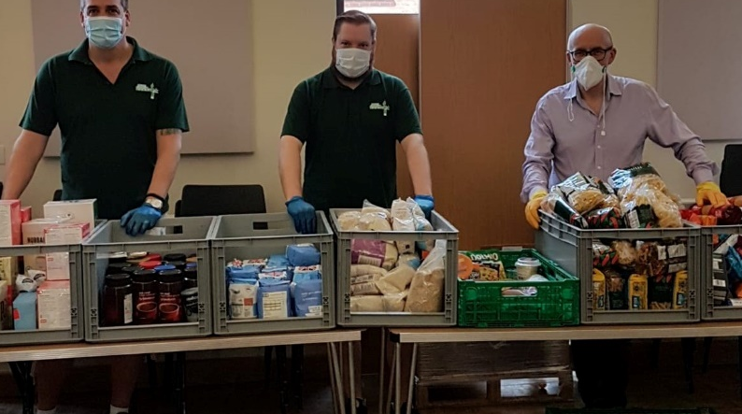
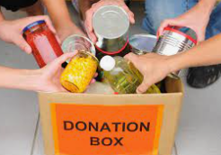
Donations
Supermarkets – Tesco, Asda, Sainsburys, Waitrose
Businesses
Community groups
Schools
Individuals
Warwick District Foodbank Is a Charitable Incorporated Organisation.
Registered charity number: 1160705 | Registered in England & Wales
Notes:
Businesses money, Natasha’s law, ood 3 months, no fresh – storage, sometimes bread – company put money aside at Tesco for bead community champion. Christmas time, harvest time. Last weekend Tesco National collection twice a year. over the three days we received 1800kgs of donations. Very generous. We get a quarterly financial contribution from tesco depending on the weight of food donated – some complicated equation to work it out.

Slide 6


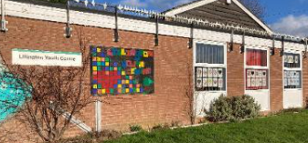


As well as providing food parcels to our own clients we are able to donate to other organisations on an ad hoc basis:
Salvation Army Way Ahead Drop-in
Lillington Youth Centre
Make Lunch Groups
School Breakfast Clubs
Leamington Helping Hands
LWS Night Shelter
Langar Aid
Church Holiday Activities
Warwick District Foodbank Is a Charitable Incorporated Organisation.
Registered charity number: 1160705 | Registered in England & Wales

