Slide 1
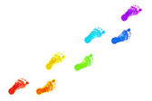
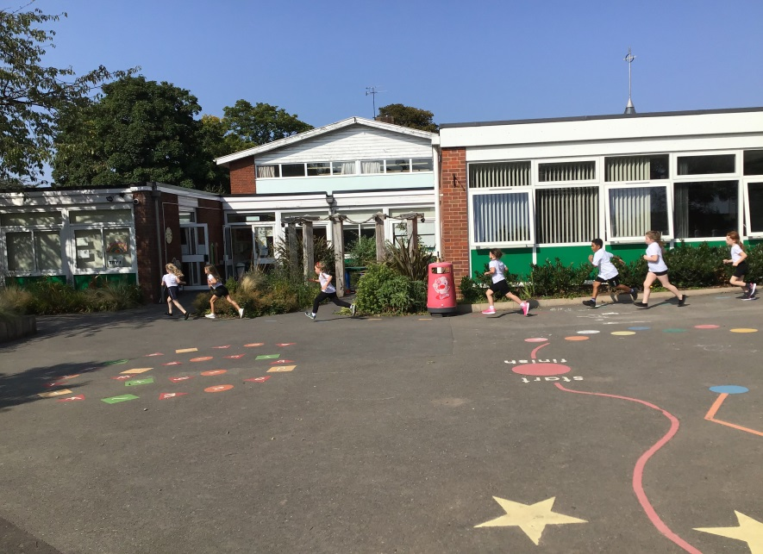
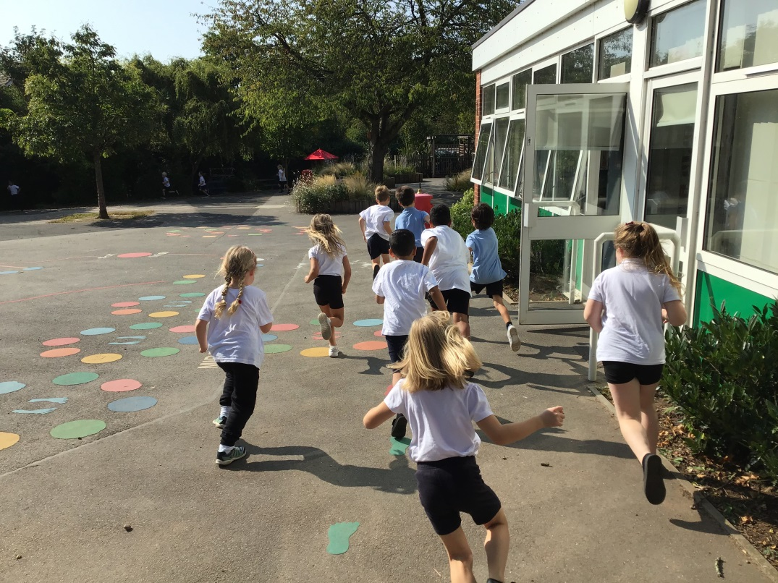
Let’s remember… Follow the multi-coloured footsteps around the edge of the playground area to run a lap and collect a band once you cross over the finish line each time.

Slide 2
½ marathon = 21.1 km certificate 1 marathon= 42.2 km certificate & medal 2 marathons= 84.4km certificate & medal

Slide 3
After your ‘Marathon Kids’ session your teacher will ask you to count up how many bands you have earned and then they can add the results to the tracking system. Each year group will have their own bucket of bands to look after.

Slide 4
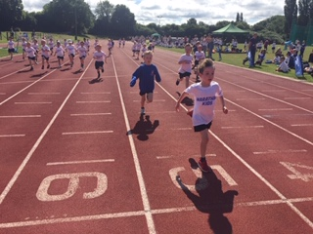
MARATHON KIDS @ EMSCOTE INFANT SCHOOL
Let’s run a half marathon or more and get invited to ‘Festival of Running’ in the summer 2021.
You can do it!!!!

