Slide 1
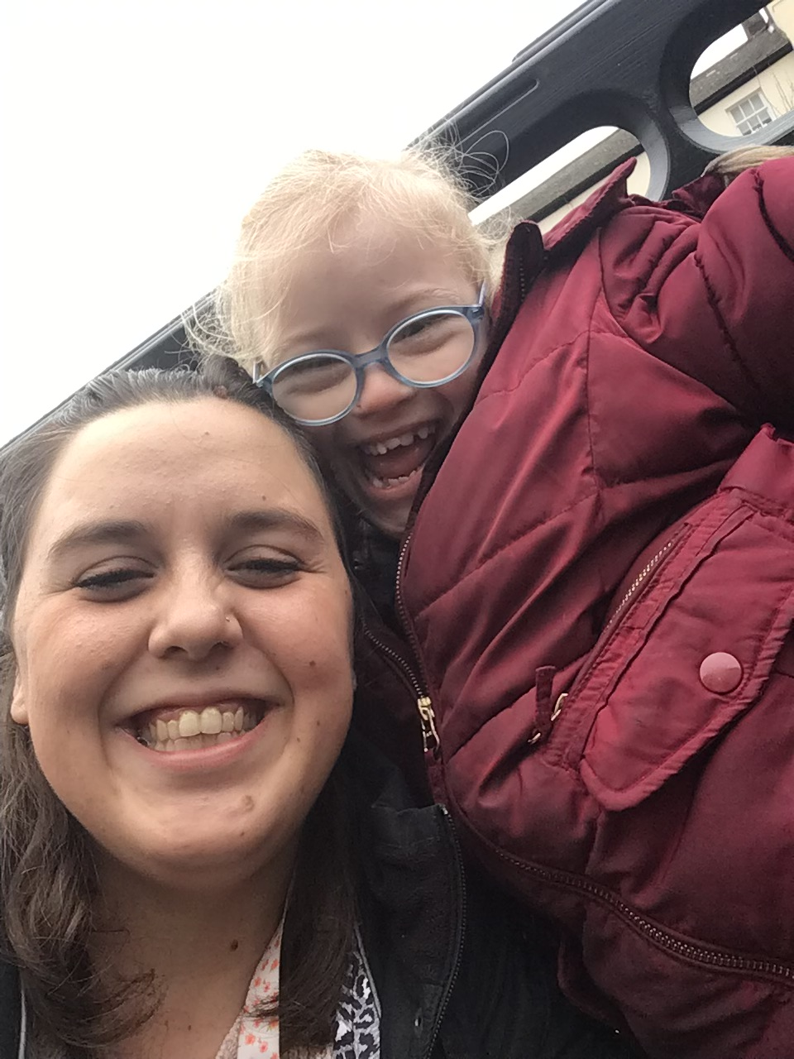
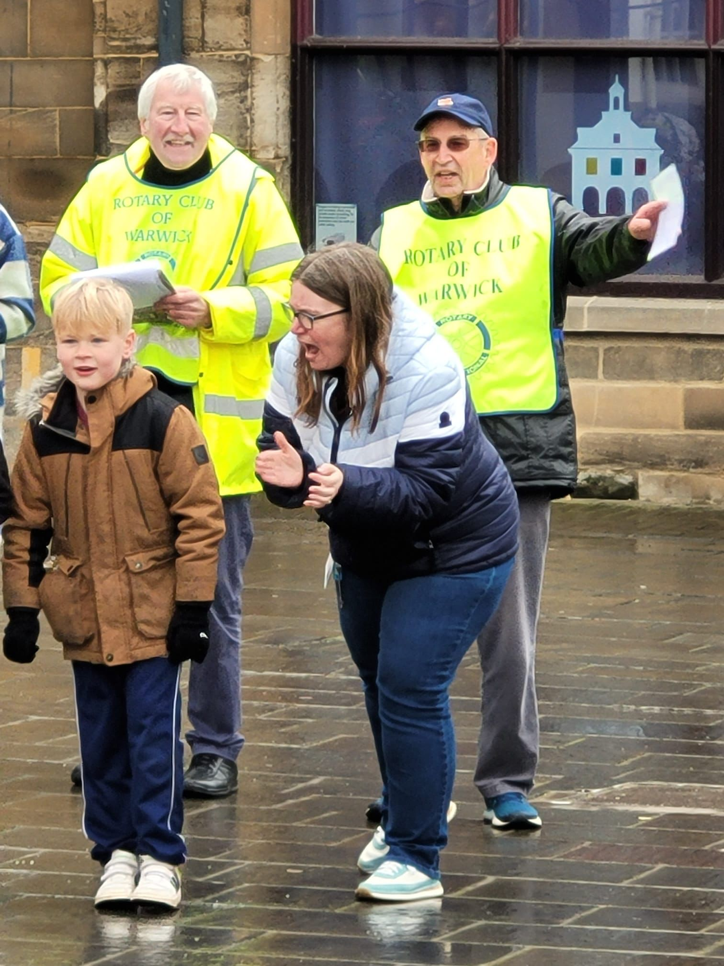
Warwick Pancake Races 2023

Slide 2
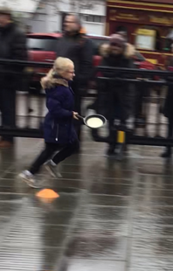
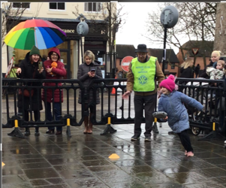
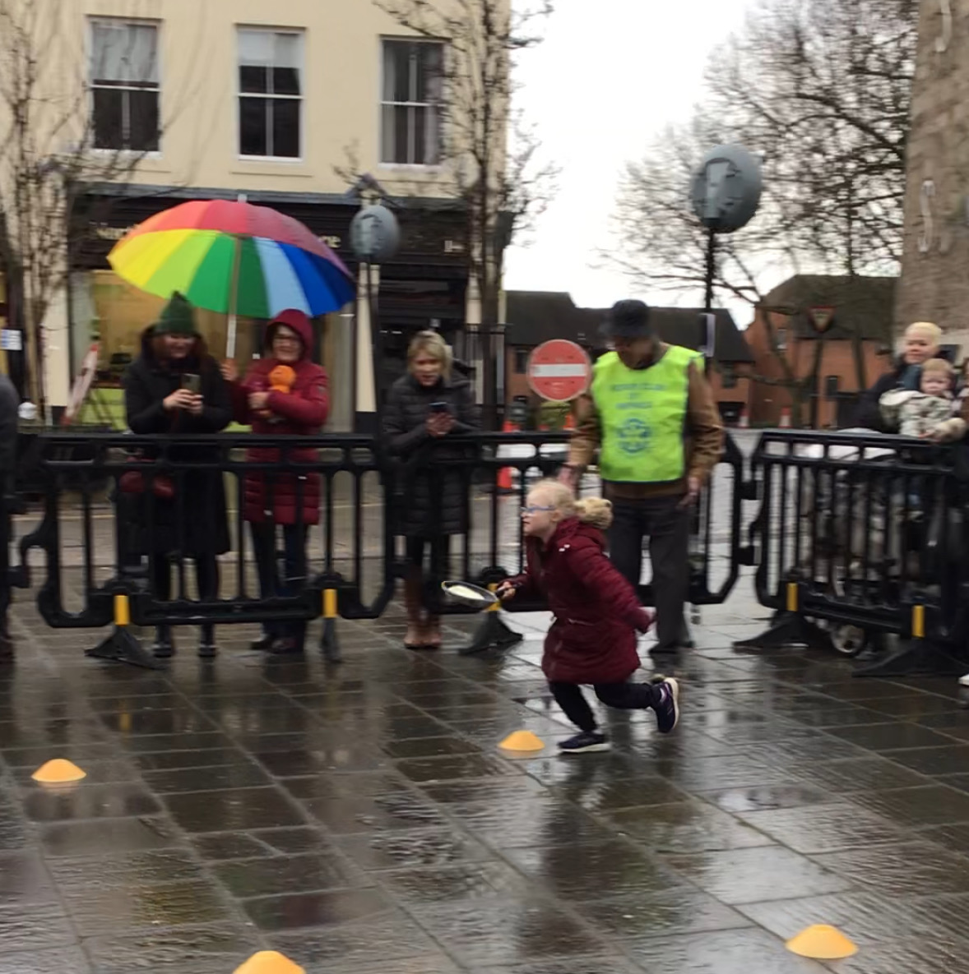
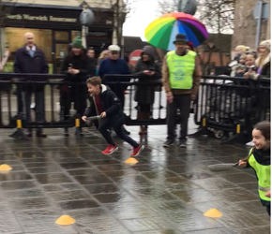
Team 1 Emscote @ Pancake Racing
Logan
Esme
Sophie
Mila
Photo courtesy of robinmyerscough (@flickr.com) - granted under creative commons licence - attribution

Slide 3
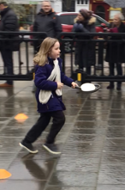
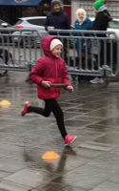
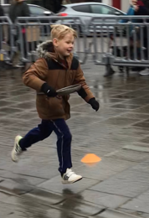
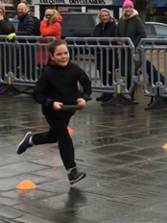
Team 2 Emscote @ Pancake Racing
Douglas
Tommy
Florence
Olivia
Photo courtesy of robinmyerscough (@flickr.com) - granted under creative commons licence - attribution

Slide 4
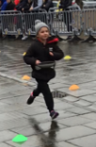
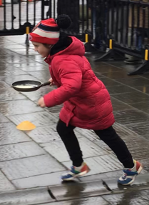
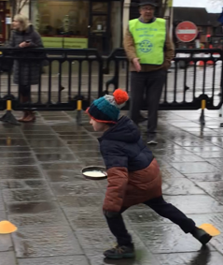
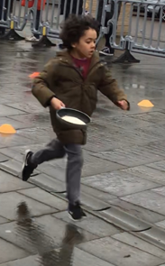
Team 3 Emscote @ Pancake Racing
Otis
Isabella
Evie
Thomas
Photo courtesy of robinmyerscough (@flickr.com) - granted under creative commons licence - attribution

Slide 5
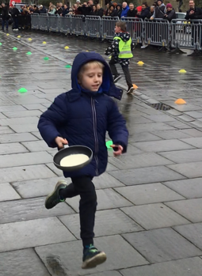
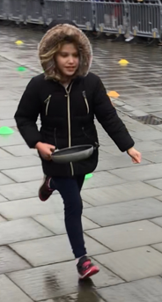
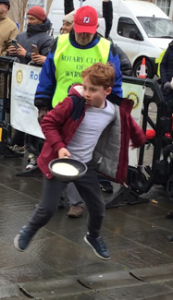
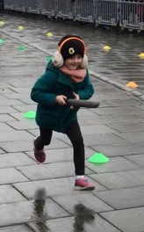
Team 4 Emscote @ Pancake Racing
Oliver
Jessica
Lily
Isaac
Photo courtesy of robinmyerscough (@flickr.com) - granted under creative commons licence - attribution

Slide 6
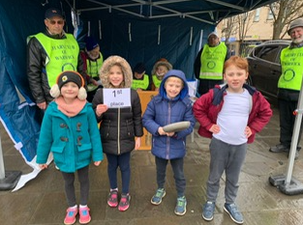
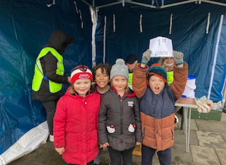
Warwick Pancake Races 2023
Our achievements
Heats
2 x first place
1 x second place
1 x third place
Final
1st and 2nd place!!!!!

Slide 7
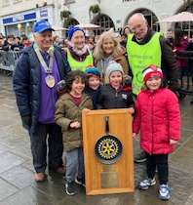
Warwick Pancake Races 2023
Great results meant
Emscote Infant school won the KS1 event!!
Our achievements
Final
1st and 2nd place!!!!!

